Slide 1




WEB PAGES DESIGN
Tables and CSS Layout
Lecturer: Dr. Atheer Akram AbdulRazzaq
Lecture 7.
Class 2.
Time: 11:30 - 1:30
Department: Businesses Information Technology (BIT)

Slide 2
Outline
Outline
Table Elements
Formatting a Data Table: Borders, Alignment, and Padding
CSS Structural Pseudo-Class Selectors
thead and tbody Elements
Cell Spanning
Web Accessibility
CSS display Property with Table Values
Relative Positioning
Summary

Slide 3
Outline
Table Elements
We can see a simple data table—the Midterm Results table in example1., It’s a data table in that it displays data, the First Name, Last Name, and Mark, in a row-column format.
Headers are not required for a data table, but they are common, and the Midterm Results table has three column headers, labeled “First Name”,” Last Name” and “Mark.”
To create a data table, start with a table container element, fill the table element with a tr element for each of its rows, and fill each tr element with th elements for header cells and td elements for data cells.
Note Example 1. table element and its four tr elements. The top tr element contains th elements for the column header cells. The bottom three tr elements contain td elements for the data cells.
If you include a caption element within a table container, the caption element must be the first element within the table. As you’d expect, a table’s caption displays above the table’s grid by default. If you want the caption’s text displayed at the bottom, you can use the following CSS type selector rule:
caption {caption-side: bottom;}

Slide 4
Outline
Table Elements (continue…)
Example 1.
<!DOCTYPE html>
<html lang="en">
<head>
<meta charset="utf-8">
<meta name="author" content="AAA">
<title>Midterm Results</title>
<style>
table, th, td {border: thin solid;}
</style>
</head>
<body>
<table>
<caption>Midterm Results</caption>
<tr><th>First Name</th><th>Last Name</th><th>Mark</th></tr>
<tr><td>Jackson</td><td>Brad</td><td>90</td></tr>
<tr><td>Janet</td><td>Smith</td><td>70</td></tr>
<tr><td>Oliver</td><td>Twist</td><td>60</td></tr>
</table>
</body>
</html>
Explicitly apply a border around the
entire table and around each cell.

Slide 5
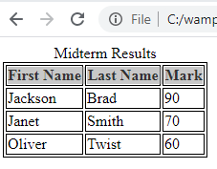
Outline
Table Elements (continue…)
Example 1. (continue…)
Output:
By default, browsers use boldface font for table header cells. You can see this behavior in Example1., where the “First Name”, “Last Name’’, and “Mark” headers (implemented with th elements) are bolder than the text values below the headers.
Formatting a Data Table: Borders, Alignment, and Padding
We’ll describe in this section how to format data tables in terms of their borders, cell alignment, and cell padding. To specify whether or not you want borders for a table, you should use CSS’s border-style property. To specify the border’s width, you should use CSS’s border-width property. For example, here’s CSS type selector rule used in Midterm Results web page: table, th, td {border: thin solid;}

Slide 6
Formatting a Data Table: Borders, Alignment, and Padding (continue…)
Outline
In this example, the border property’s first value is thin, which goes with the border-width property, and the border property’s second value is solid, which goes with the border-style property.
With table, th, and td all listed in the rule, the resulting web page displays a thin solid border around the entire table (except for the table’s caption), around each header cell, and around each data cell.
Now onto the next two formatting features—cell alignment and cell padding. If you add no CSS to a table, then you’ll end up using the browser’s default CSS values.
Table data cells (td) have a default alignment of left. Both th and td cells have a default padding of none.
To adjust the horizontal alignment of text in table cells, use CSS’s text-align property with a value of left, right, or center. To adjust the padding around text in table cells, use CSS’s padding property with a pixel value (e.g., 5px).
To add left alignment and padding to every cell, use this type selector rule:
th, td {
text-align: left;
padding: 10px;
}

Slide 7
Formatting a Data Table: Borders, Alignment, and Padding (continue…)
Outline
Example 2.
<!DOCTYPE html>
<html lang="en">
<head>
<meta charset="utf-8">
<meta name="author" content="AAA">
<title>Midterm Results</title>
<style>
table, th, td {border: thin solid;}
th, td {text-align: left; padding: 15px; }
table {border-width: medium;}
th {border-bottom-width: thick;}
</style>
</head>
<body>
<table>
<caption>Midterm Results</caption>
<tr><th>First Name</th><th>Last Name</th><th>Mark</th></tr>
<tr><td>Jackson</td><td>Brad</td><td>90</td></tr>
<tr><td>Janet</td><td>Smith</td><td>70</td></tr>
<tr><td>Oliver</td><td>Twist</td><td>60</td></tr>
</table>
</body>
</html>

Slide 8
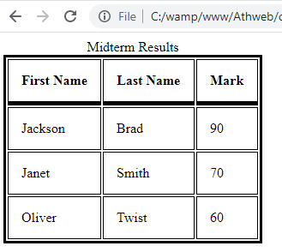
Formatting a Data Table: Borders, Alignment, and Padding (continue…)
Outline
Example2. (continue…)
Output:
In example 1., style container contains the following CSS rule, which creates thin border lines around the entire table and also around each cell:
table, th, td {border: thin solid;}
To assign a medium width to the table’s outer border and to assign a thick width to the header cells’ bottom borders, add the following type selector rules below rule:
table {border-width: medium;}
th {border-bottom-width: thick;}

Slide 9
Formatting a Data Table: Borders, Alignment, and Padding (continue…)
Outline
Note that all three rules deal with borders. The first and second rules both provide values for the table element’s border-width property. The second rule’s border-width property is explicit (border-width: medium), whereas the first rule’s border-width property is built into the border shorthand property (border: thin).
If two CSS rules refer to the same property, the rule that appears later overrides the prior rule’s property value. Therefore, because the border-width: medium rule appears later, it wins and the table’s border width will be medium.
In example 2., note how there’s a gap between each of the borders. More specifically, there’s a gap between the table’s exterior border and the individual cells’ borders, and there’s a gap between the borders for adjacent cells. If you’d like to eliminate those gaps and merge the borders, use the border-collapse CSS property with a value of collapse, like this:
table {border-collapse: collapse;}
Example 3.
<!DOCTYPE html>
<html lang="en">
<head>
<meta charset="utf-8">
<meta name="author" content="AAA">
<title>Midterm Results</title>

Slide 10
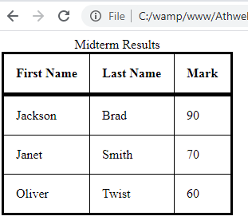
Formatting a Data Table: Borders, Alignment, and Padding (continue…)
Outline
Example 3. (continue…)
<style>
table, th, td {border: thin solid;}
th,td {text-align: left; padding: 15px; }
table {border-width: medium;}
th {border-bottom-width: thick;}
table {border-collapse: collapse;}
</style>
</head>
<body>
<table>
<caption>Midterm Results</caption>
<tr><th>First Name</th><th>Last Name</th><th>Mark</th></tr>
<tr><td>Jackson</td><td>Brad</td><td>90</td></tr>
<tr><td>Janet</td><td>Smith</td><td>70</td></tr>
<tr><td>Oliver</td><td>Twist</td><td>60</td></tr>
</table>
</body>
</html>
Output:

Slide 11
Outline
CSS Structural Pseudo-Class Selectors
When you have a collection of elements, sometimes you want to display one or more of those elements differently from the rest.
You would then use the class attribute’s value as a class selector in a CSS rule. But if the number of elements that you want to display with a special format is large, then quite a few class="value" code insertions would be required.
When there is regularity in the locations of certain elements within a collection of elements, you can avoid the class="value" code insertions described and, instead, implement that functionality with a structural pseudo-class CSS rule.
For example, the following code uses a standard tr type selector to select all the tr elements in a web page, and the :first-of-type pseudo-class checks each of those elements to see if it is a first tr element within a particular table:
tr:first-of-type {background-color: palegreen;}
For each conditionally selected tr element (i.e., for each first-row tr element), the browser displays the element with a pale green background color.
The W3C defines 12 structural pseudo-classes, but we’ll focus on three of the most popular ones; they are :first-of-type, :last-of-type, and :nth-of-type().
When we see the figure 1., all pseudo-classes start with a colon. The purpose of a pseudo-class is to qualify a standard selector. More specifically, it provides a condition for selecting an element(s) from among the elements selected by a standard selector.

Slide 12
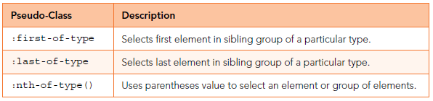
CSS Structural Pseudo-Class Selectors (continue…)
Outline
For a first tr element from among a group of sibling tr elements. Sibling elements are elements that have the same parent element. :last-of-type. As you might guess, the :last-of-type pseudo-class checks each of the elements selected by a standard selector to see if the element is a last element from among a group of sibling elements.
So following example selects li elements that are at bottom of unordered lists:
ul > li:last-of-type {background-color: palegreen;}
Note the ul > li child selector notation, which means that an li element is selected only if it is a child of a ul element.
Note that there are no spaces on either side of the pseudo-class’s colon.
The :nth-of-type() pseudo-class has parentheses. Inside the parentheses, you provide a value that indicates which element or group of elements you want to select.
For example, in the following CSS rule, we put 3 in the parentheses to select the third data cell within a row of sibling data cells:
td:nth-of-type(3) {text-align: right;}
As an alternative to putting a number in the parentheses, you can specify even or odd. For example, in the following CSS rule, we put even in the parentheses to select every even-numbered row:
tr:nth-of-type(even) {background-color: lightblue;}
Figure 1. Popular structural pseudo-class selectors

Slide 13
CSS Structural Pseudo-Class Selectors (continue…)
Outline
We can use an expression of the form an + b, where a and b are constant integers and n is a variable named n. By using such an expression, we can specify interleaved groups of elements. This is better explained with an example:
tr:nth-of-type(5n+2) {background-color: red;}
That rule selects every fifth tr element starting with the second row. In other words, it selects rows 2, 7, 12, 17, and so on.
Example 4.
<!DOCTYPE html>
<html lang="en">
<head>
<meta charset="utf-8">
<meta name="author" content=“AAA">
<title>Local Power Generation and Consumption</title>
<style>
h3 {text-align: center;}
table {border-collapse: collapse; margin: 0 auto;}
th, td {border: thin solid; padding: 2px 5px;}
td:nth-of-type(3), td:nth-of-type(4) {text-align: right;}
tr:first-of-type {background-color: palegreen;}
tr:nth-of-type(2n+3) {background-color: palegoldenrod;}
</style>
</head>
These rules use structural
pseudo-class selectors.

Slide 14
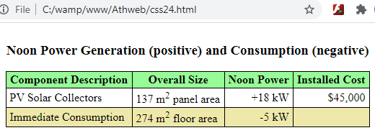
CSS Structural Pseudo-Class Selectors (continue…)
Outline
Example 4. (continue…)
<body>
<table>
<caption>
<h3>Noon Power Generation (positive) and Consumption (negative)</h3>
</caption>
<tr>
<th>Component Description</th> <th>Overall Size</th>
<th>Noon Power</th> <th>Installed Cost</th>
</tr>
<tr>
<td>PV Solar Collectors</td> <td>137 m<sup>2</sup> panel area</td>
<td>+18 kW</td> <td>$45,000</td>
</tr>
<tr>
<td>Immediate Consumption</td> <td>274 m<sup>2</sup> floor area</td>
<td>-5 kW</td><td> </td>
</tr>
</table>
</body>
</html>
Output:

Slide 15
thead and tbody Elements
Outline
Normally, we’ll put table header cells at the top of a table’s columns, but sometimes we’ll also want to put them at the left of each row.
For example, in the Global Temperatures web page in example 5., note the year values in header cells at the left. If you have header cells at the left, very often you’ll want to differentiate those header cells from the ones at the top.
The preferred way to differentiate is to put the top cells’ row (or rows) in a thead element and put the subsequent rows in a tbody element.
In the example 5., the thead element contains a tr element and three th elements within the tr element. The tbody element contains several tr elements, with each tr element holding a th element and two td elements.
Here are simplified versions of the descendant selector rules used to color thead’s header cells differently from tbody’s header cells:
thead th {background-color: midnightblue;}
tbody th {background-color: mediumvioletred;}
Besides using thead and tbody, there are other ways to distinguish the top header cells from the left-side header cells. For example, you could use class attributes with one value for top header cells and a different value for left-side header cells.
Let’s now examine a few noteworthy CSS rules from the Global Temperatures web page that are unrelated to thead and tbody. Here’s the first such rule:
body {display: flex; justify-content: center;}

Slide 16
thead and tbody Elements (continue…)
Outline
In the CSS rule, the display: flex; property-value pair creates a flexbox layout (also called a flexible box layout). It provides the ability to add certain formatting features to a standard block element.
We should be familiar with this alternative technique, which is pervasive throughout the web page universe:
table {margin: 0 auto;}
The code shows two values for the margin property—0 and auto.
The first value specifies the top and bottom margins and the second value specifies the left and right margins. So with the first value being 0 in the CSS rule, there are no margins above and below the table.
The auto value requires some additional explanation. For any block element (including a table element), if the left margin and right margin are both set to auto, that will force the browser to make the margins equal, which forces the browser to center the block element.
Another rule from the Global Temperatures web page that deserves some attention:
thead th {vertical-align: bottom;}
If you need top or middle vertical alignment, use the vertical-align property with a value of top or middle, respectively.

Slide 17
thead and tbody Elements (continue…)
Outline
Note this additional CSS rule from the Global Temperatures web page, copied here for your convenience:
table, th, td {border: none;}
The border: none property-value pair means that browser will not draw border lines.
There is one final noteworthy item in the code for the Global Temperatures web page. The table’s first row contains this th container code:
<th>Avg<br>Temp (&deg;F)</th>
Example 5.
<!DOCTYPE html>
<html lang="en">
<head>
<meta charset="utf-8">
<meta name="author" content=“AAA">
<title>Global Temperatures</title>
<style>
body {display: flex; justify-content: center;}
table, th, td {border: none;}
th, td {padding: 10px;}
thead th {
background-color: midnightblue;
color: white;
vertical-align: bottom;
}
To center a block element
(like table), apply this CSS
code to the element's
parent container.
To position text vertically
within its container, use
The vertical-align property.

Slide 18
thead and tbody Elements (continue…)
Outline
Example 5. (continue…)
tbody th {
background-color: mediumvioletred;
color: white;
}
td {
background-color: mistyrose;
text-align: center;
}
</style>
</head>
<body>
<table>
<caption>Average Annual Global Temperatures</caption>
<thead>
<tr>
<th>Year</th>
<th>Temp<br>Rank</th>
<th>Avg<br>Temp (&deg;F)</th>
</tr>
</thead>
<tbody>
<tr><th>2016</th><td>1</td><td>58.98</td></tr>
<tr><th>2015</th><td>2</td><td>58.77</td></tr>
If a row's content is too long
to fit on one line, then put
indented cell elements on
separate lines.

Slide 19
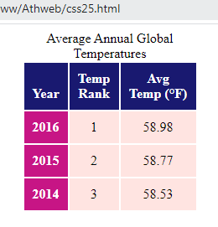
thead and tbody Elements (continue…)
Outline
Example 5. (continue…)
<tr><th>2014</th><td>3</td><td>58.53</td></tr>
</tbody>
</table>
</body>
</html>
Output:
Cell Spanning
All of our data table examples have used a standard grid pattern, with one cell for each row-column intersection. But sometimes data tables will have cells that span more than one of the intersections in a standard grid.
For example, see the My Favorite Eras table in example 6., We implemented it using a table element with six rows and three columns.
The Events cell at the top is a merged version of two cells in the first row. The Mesozoic cell at the left is a merged version of two cells in the first column. Below the Mesozoic cell, the Cenozoic cell is a merged version of the next three cells in the first column.

Slide 20
Cell Spanning (continue…)
Outline
If you want to create a merged cell that spans more than one column, you’ll need to add a colspan attribute to a th or td element.
In particular, examine the code for the table’s first row, and note colspan="2", which creates a merged cell that spans two columns. We’ve copied the code here for your convenience:
<tr><th>Eras</th><th colspan="2">Events</th></tr>
Example 6.
<!DOCTYPE html>
<html lang="en">
<head>
<meta charset="utf-8">
<meta name="author" content="AAA">
<title>Earth Eras</title>
<style>
table {border: thin solid;}
th, td {border: thin solid; padding: 10px;}
thead th {background-color: lawngreen;}
tbody th {background-color: lightcyan;}
</style>
</head>
<body>
<table>
<caption>My Favorite Eras</caption>

Slide 21
Cell Spanning (continue…)
Outline
colspan attribute
Example 6. (continue…)
<thead>
<tr><th>Eras</th><th colspan="2">Events</th></tr>
</thead>
<tbody>
<tr>
<th rowspan="2">Mesozoic<br>251 to 65.5 mya</th>
<td>Evolutionary split between reptiles and dinosaurs</td>
<td>235 mya</td>
</tr>
<tr>
<td>South America breaks away from Africa</td>
<td>105 mya</td>
</tr>
<tr>
<th rowspan="3">Cenozoic<br>65.5 mya to today</th>
<td>Modern mammals appear</td>
<td>40 mya</td>
</tr>
<tr><td>Tool-making humanoids appear</td><td>2 mya</td></tr>
<tr>
<td>First Rolling Stones reunion tour</td>
<td>11,000 years ago</td>
</tr>
</tbody>
</table>
</body>
</html>
rowspan attribute

Slide 22
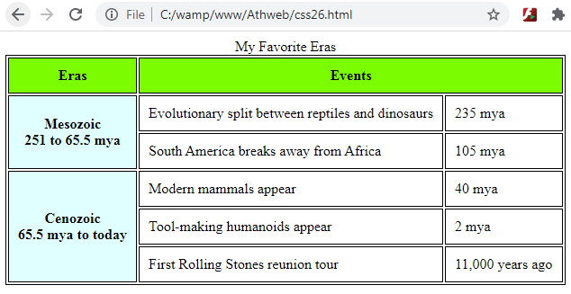
Cell Spanning (continue…)
Outline
Example 6. (continue…)
Output:
Web Accessibility
Web accessibility means that disabled users can use the Web effectively. Most web accessibility efforts go toward helping users with visual disabilities, but web accessibility also attempts to address the needs of users with hearing, cognitive, and motor skills disabilities.
Typically, visually impaired users have screen readers to read web pages. A screen reader is software that figures out what the user’s screen is displaying and sends a text description of it to a speech synthesizer. The speech synthesizer then reads the text aloud.
In particular, you should consider embedding a details element in the table’s caption element. The details element provides a description of the table’s content so that a screen reader can read the description and get a better understanding of the nature of the table’s organization.

Slide 23
Web Accessibility (continue…)
Outline
In the example 7., note the right-facing triangle under the table’s title. If the user clicks the triangle, the browser will display “help” details that describe the table’s content. The triangle and the text that describes the table both come from a details element embedded in the table’s caption element.
Screen readers will use that text to describe the table’s organization.
Besides the details element, another way to help screen readers understand complicated data tables is to use the headers attribute.
We specify the header cell(s) that each data cell or subheader cell is associated with. For example, in the Grading Weights table, the 36% data cell is associated with the Exams header cell and also the 2 subheader cell immediately above the 36% cell. So to help with web accessibility, the 36% cell has a headers attribute that specifies those two header cells, here’s the relevant code in example 7.
<td headers="exams exam2">36%</td>
The “exams” and “exam2” values match the id values for the Exams header cell and the 2 subheader cell immediately above the 36% cell. Here’s the relevant code from example 7.
<th colspan="2" id="exams">Exams</th>
...
<th id="exam2" headers="exams">2</th>

Slide 24
Web Accessibility (continue…)
Outline
what if a table element is used for layout purposes, and the cells are not organized by rows and columns? If a screen reader reads such a table and doesn’t know that it’s a layout table, it will provide unhelpful (and possibly confusing) information.
To avoid this problem, if you have a table element being used for layout purposes, you should add a role attribute to the table element’s start tag, like this:
<table role="presentation">
Example 7.
<!DOCTYPE html>
<html lang="en">
<head>
<meta charset="utf-8">
<meta name="author" content="AAA">
<title>Grading Weights</title>
<style>
table, th, td {border: thin solid;}
th, td {
text-align: center;
padding: 10px;
}
caption {margin-bottom: 15px;}
</style>
</head>

Slide 25
Web Accessibility (continue…)
Outline
Example 7. (continue…)
<body>
<table>
<caption>
Grading Weights for Web Programming I
<details>
<summary>Help</summary>
The first 3 columns show weights for the 3 homework assignments.
The next 2 columns show weights for the 2 exams.
The last column shows the weight for staying awake during class.
</details>
</caption>
<tr>
<th colspan="3" id="hw">Homework Assignments</th>
<th colspan="2" id="exams">Exams</th>
<th rowspan="2" id="awake">Ability to<br>Stay Awake</th>
</tr>
<tr>
<th id="hw1" headers="hw">1</th>
<th id="hw2" headers="hw">2</th>
<th id="hw3" headers="hw">3</th>
<th id="exam1" headers="exams">1</th>
<th id="exam2" headers="exams">2</th>
</tr>

Slide 26
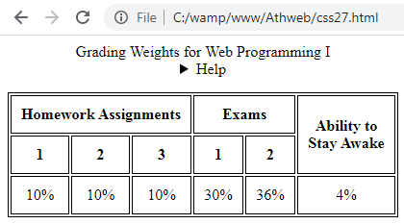
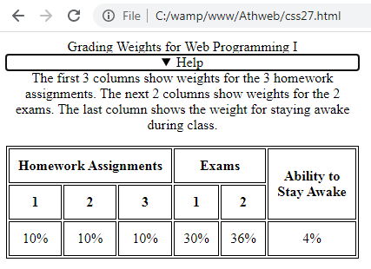
Web Accessibility (continue…)
Outline
Example 7. (continue…)
<tr>
<td headers="hw hw1">10%</td>
<td headers="hw hw2">10%</td>
<td headers="hw hw3">10%</td>
<td headers="exams exam1">30%</td>
<td headers="exams exam2">36%</td>
<td headers="awake">4%</td>
</tr>
</table>
</body>
</html>
Output:

Slide 27
CSS display Property with Table Values
Outline
Now it’s time to discuss how to implement layout tables the right way—using CSS rather than the table element. There are two main ways to implement layout tables with CSS.
The display Property’s Table Values
The display property can be used for much more than just inlining block element content. It can also be used to emulate the various parts of a table. In the figure 2., first display property value is table. The table value enables an element, like a div element, to behave like a table. Here’s how you can do that:
<style>
.table {display: table;}
...
</style>
<body>
<div class="table">
...
</div>
</body>
In figure 2., the table-header-group value causes its rows to display before all other rows and after any table captions. If a table contains multiple elements with table-header-group values, only the first such element behaves like a thead element; the others behave like tbody elements.

Slide 28
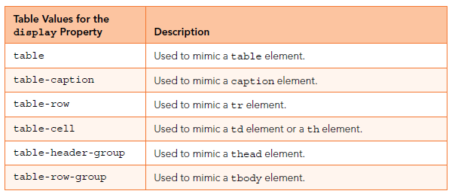
CSS display Property with Table Values(continue…)
Outline
In example 8., Ancient Wonders style container, note the CSS rules that use the .table, .caption, and .row class selectors.
In the body container, note how those selector names are used to implement a table using div elements—<div class="table">, <div class="caption">, and <div class="row">.
We need to use the table-cell value. In the Ancient Wonders table, each cell in the first row holds a picture, so our first implementation effort attempted to use the pictures’ img elements as the targets for a table-cell rule, like this:
img {display: table-cell;}
Figure.2 Table values for the CSS display property

Slide 29
CSS display Property with Table Values(continue…)
Outline
Example 8.
<!DOCTYPE html>
<html lang="en">
<head>
<meta charset="utf-8">
<meta name="author" content=“AAA">
<title>Ancient Wonders</title>
<style>
.table {
display: table;
border-spacing: 20px;
}
.caption {
display: table-caption;
font-size: xx-large;
text-align: center;
}
.row {display: table-row;}
.row > * {
display: table-cell;
text-align: center;
}
</style>
</head>
For table behavior.
For caption behavior.
For tr behavior.
This causes all children
of .row elements to
behave like table cells
(i.e., td or th elements).

Slide 30
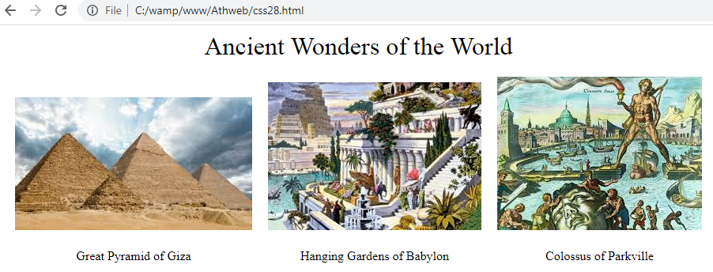
CSS display Property with Table Values(continue…)
Outline
Example 8. (continue…)
<body>
<div class="table">
<div class="caption">Ancient Wonders of the World</div>
<div class="row">
<span><img src="pyramid.jpg" alt=""></span>
<span><img src="hangingGardens.jpg" alt=""></span>
<span><img src= "colossus.jpg" alt=""></span>
</div>
<div class="row">
<span>Great Pyramid of Giza</span>
<span>Hanging Gardens of Babylon</span>
<span>Colossus of Parkville</span>
</div>
</body>
</html>
Output:
This causes this div element
to behave like a table.
This causes this div element
to behave like a caption.
This causes this div element to behave like a row.

Slide 31
CSS display Property with Table Values(continue…)
Outline
You might recall that the > symbol is known as a combinator because it combines two selectors into one. The selector at the left, .row, matches all the elements in the Ancient Wonders web page that have class="row". The universal selector at the right, *, matches any element.
To avoid that ugliness, you can use the border-spacing property, and that’s what we did in the Ancient Wonders style container:
.table {
display: table;
border-spacing: 20px;
}
The border-spacing property allows you to specify horizontal and vertical cell spacing separately. Here’s an example:
border-spacing: 15px; 25px;
The first value, 15px, specifies horizontal spacing, and the second value, 25px, specifies vertical spacing. Horizontal spacing refers to the width of the gap between adjacent cells in the same row. Vertical spacing refers to the height of the gap between adjacent cells in the same column.
Relative Positioning
As an alternative, you can position an element relative to its normal flow within its surrounding content. That’s called relative positioning.
In the example 10. In the Aphorism web page’s CSS rules, note the position: relative property-value pairs.

Slide 32
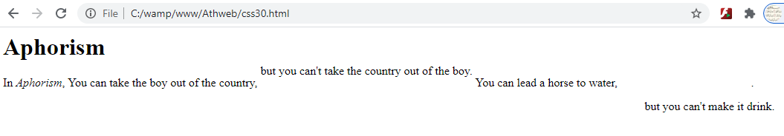
Outline
Relative Positioning (continue…)
In the .down CSS rule, note the property-value pairs top: 2em and left: 2em.
Positive values for the top property move the element down, and positive values for the left property move the element to the right.
Example 9.
<h1>Aphorism</h1>
<style>
.up {
position: relative;
top: -1em;
}
.down {
position: relative;
top: 2em;
left: 2em;
}
</style>
<p>
In <cite>Aphorism</cite>, You can take the boy out of the country, <span class="up">but you can't take the country out of the boy.</span>
You can lead a horse to water, <span class="down">but you can't make it drink.</span>.
</p>
Output:

Slide 33
Outline
Summary
In this lecture we started with a table container element, and fill the table element with a tr element for each of its rows, and fill each tr element with th elements for header cells and td elements for data cells.
Also explained briefly the formatting a data Table: Borders, Alignment, and Padding.
We explained the CSS pseudo-class that is a keyword added to a selector that specifies a special state of the selected element(s). Also a pseudo-class is called a “pseudo-class” because using a pseudo-class is similar to using a class attribute, but the two entities are not identical.
We described in this lecture the meaning of The <thead> tag that used to group header content in an HTML table. The <thead> element is used in conjunction with the <tbody> element to specify each part of a table (header, and body).
This lecture clarified the meaning of cell spanning, which is the property specifies the number of grid columns spanned by a cell, column, or column group. A cell box occupies a rectangle of 'column-span' by 'row-span' grid cells in a table.
We explained also in this lecture the web accessibility means that disabled users can use the Web effectively.
We explained also in this lecture the web accessibility means that disabled users can use the Web effectively. it's building web experiences that are usable by all. Just as the web itself has grown, so has the diversity of its users.
Also this lecture described the meaning of CSS display Property with Table Values.
We explained briefly the relative positioning meaning that is positioned relative to its normal position.

Slide 34


THANK YOU

